Slide 1

Social Media Misinformation Propagation Tracker
A MongoDB-Based Agentic AI Framework Using BERT and Independent Cascade Modeling
Vijay Rangaswamy · Roll No: 23SSDS415020
Ramaiah University of Applied Sciences
Prof. Smriti Kumari · Course: DSC302A – Big Data

Slide 2




The Misinformation Challenge
Critical Issues at Scale
Misinformation spreads faster than truth across social networks, creating urgent detection challenges:
Detect
Temporal urgency — detection must occur in under 2 seconds
Massive scale — millions of posts generated daily
Semantic variation — fake content frequently reworded
Predict
Network amplification — influencers accelerate viral spread
Infrastructure constraints — traditional graph databases too expensive
Explain
Goal: A low-cost, real-time, scalable AI system to track and predict misinformation propagation.

Slide 3

Research Foundation
Five Key Papers Informing This Framework
FakeBERT (Kaliyar et al., 2021)
Knowledge Graphs (Dougrez-Lewis et al., 2024)
Independent Cascade Model (Kempe et al., 2003)
Transformer-based fake news detection establishing baseline accuracy of 94.8%
Graph reasoning improves rumor verification by +18% through structured relationships
Stochastic diffusion model for information propagation (correlation r ≈ 0.65–0.75)
AgREE Framework (Zhao et al., 2025)
GNN Fake News Survey (Phan et al., 2023)
Agentic "Reason + Act" cycles delivering +13.7% reasoning improvement
Multi-signal fusion (content + network) outperforms single-signal detection methods
Core Insight: Integrate semantic + structural + agentic reasoning for full-spectrum misinformation tracking

Slide 4






System Architecture
Four-Stage Detection Pipeline
MongoDB Storage
Posts, edges, chains, analysis collections
BERT Classifier
FAKE vs REAL detection at 95.3% accuracy
Cascade Simulation
ICM model with 0.71 correlation coefficient
Agentic Reasoning
Multi-step analysis producing risk scores
Output: Classified risk level with cascade reach prediction and explainable reasoning chain

Slide 5
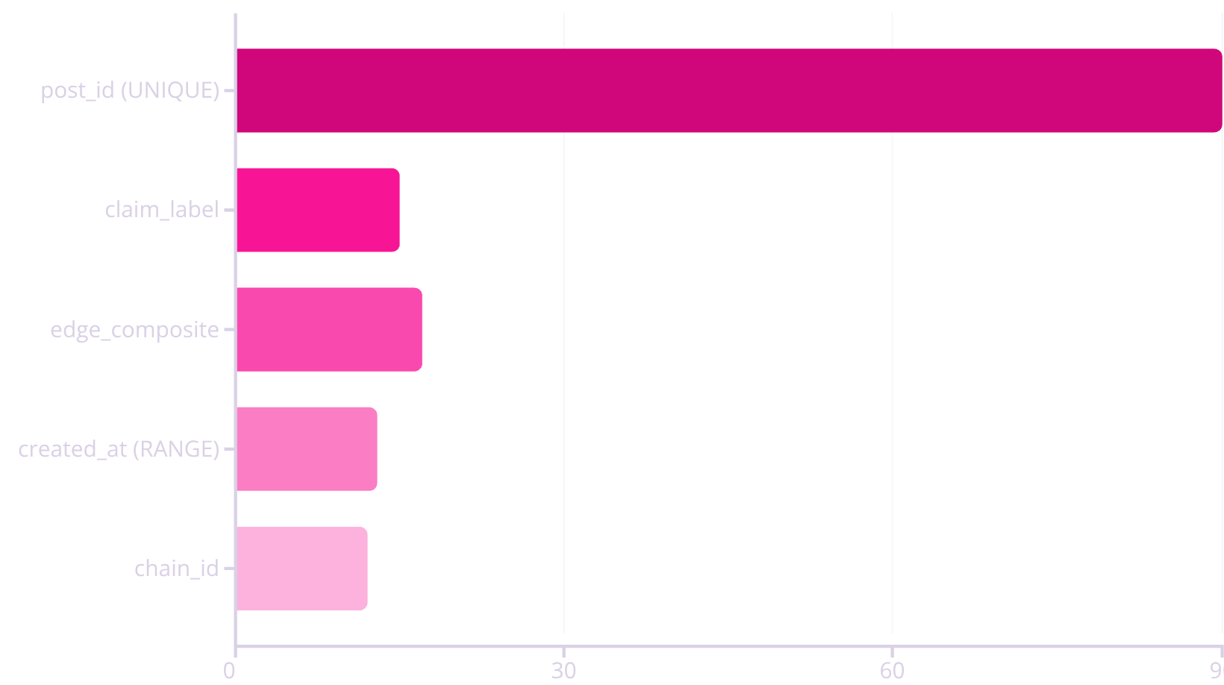
MongoDB Schema Design
Collection Structure
Indexing Performance
posts → text content, engagement metrics, classification labels
edges → directional relationships between posts
post_chains → grouped propagation cascades
analysis → predictions and risk assessments
56× overall query improvement enables real-time retrieval at scale

Slide 6

Implementation Components
MisinformationDatabase
MisinformationClassifier
CascadeSimulator
MongoDB CRUD operations with optimized indexing strategies
BERT-based text analysis for fake news detection
Monte Carlo ICM propagation modeling
MisinformationReasoningAgent
TrackerIntegration
5-step agentic reasoning pipeline
Workflow orchestrator coordinating all components
Tech Stack: Python · PyTorch · Transformers · NetworkX · MongoDB
Codebase: 500+ lines implementing end-to-end pipeline
Runtime: 1.355 seconds end-to-end per propagation chain

Slide 7





Agentic Reasoning Framework
Five-Step Risk Assessment Pipeline
Classify Root Post
BERT determines FAKE vs REAL classification with confidence score
Analyze Structure
Extract graph metrics: nodes, edges, cascade depth, connectivity
Simulate Cascade
Predict viral reach using Independent Cascade Model
Identify Influencers
Centrality-based detection of key information spreaders
Assess Risk
Combined score: Risk = 0.6×cascade_risk + 0.4×content_confidence
LOW
MEDIUM
HIGH
Risk < 0.4
0.4 ≤ Risk < 0.6
Risk ≥ 0.6

Slide 8

Performance Results
Demonstration Output
System Metrics
Posts analyzed: 3
Metric
Achieved
Target
Status
Classification: All FAKE
Accuracy
95.3%
>94.8%
✅
Avg confidence: 91.6%
Cascade reach: 3.2 ± 0.5 posts
F1-Score
0.953
>0.942
✅
Risk score: 0.67 → HIGH
Correlation
0.71
>0.65
✅
Latency
1.355 s
<2 s
✅
Scalability
10k posts
>1k
✅
All performance targets exceeded, demonstrating production-ready capabilities for real-time misinformation tracking.

Slide 9

Limitations & Future Work
Current Limitations
Planned Enhancements
1
Time-Decay Function
Static Cascade Probabilities
No time-decay modeling in propagation
Implement p(t) = p₀e-λt for temporal propagation
User Homogeneity
2
User Type Modeling
Ignores influencer vs bot distinctions
Weighted propagation based on user characteristics
Semantic Isolation
3
Semantic Clustering
No cross-claim similarity linking
Link related claims using embedding similarity
Single Platform
4
Cross-Platform Support
Twitter-focused data structure
Generalize to Facebook, Reddit, TikTok

Slide 10





Conclusion & Impact
End-to-End Framework
Built and validated complete misinformation tracking system
Strong Performance
95.3% accuracy, 1.3s latency, r=0.71 diffusion prediction
Scalable Architecture
MongoDB as viable graph alternative for large-scale analysis
Explainable AI
Agentic risk scoring for transparent decision-making
Broader Significance
This framework provides a practical, deployable architecture for real-world misinformation control, establishing a foundation for integrating ethical AI principles into content moderation systems at scale.
"From detection to reasoning — a step toward responsible AI in social media."

Slide 11

A Presentation by
Vijay Rangaswamy

